Slide 1

MINOR PROJECT- COLLEGE MANAGEMENT SYSTEM
Learning Objectives
Develop menu –driven applications in c++
Apply authentication in menu-driven project
Apply the file-handling concepts

Slide 2
COLLEGE MANAGEMENT SYSTEM(SMS)
INTRODUCTION-:
CMS is a command –driven application that helps to maintain student and faculty records. It makes use of unique IDs and password to restrict the access and usage of different areas of the portal to its correct target audience. The faculty portal allows the faculty user to update profile, allocations subjects.
Likewise, The student portal helps to maintain student profile information, allocations and de-allocations of students. The admin portal is used to administrative purposes. Its helps to make the user entry for the first time.

Slide 3
CONCEPT AND FEATURES
# Concept of Inheritance for code reusability.
# Concept of function overloading that enhance the code readability.
# Handling of Simple exceptions
# Application of file –handling concepts for performing
operations, such as-read, write, append, check for
various I/O errors, etc.
# Use of various I/O manipulators to display the output in formatted manner

Slide 4


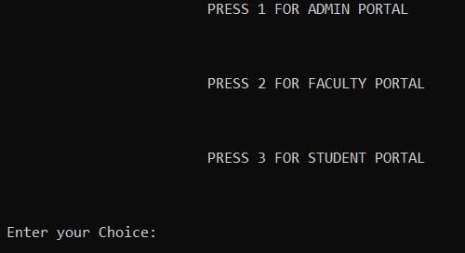
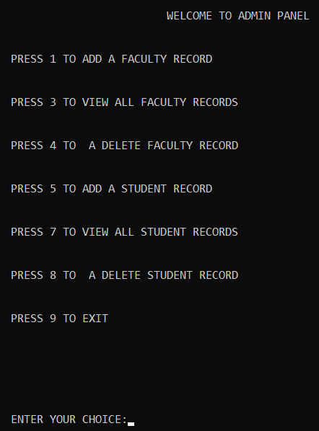
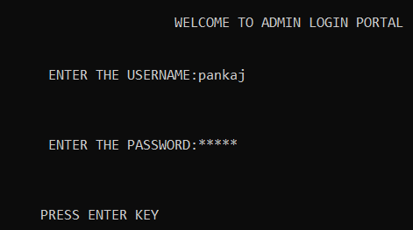
1

Slide 5
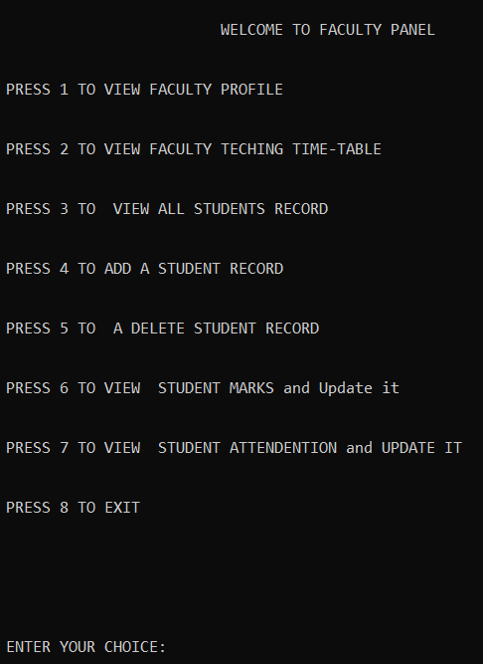
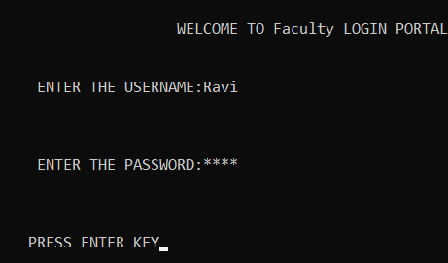

Slide 6
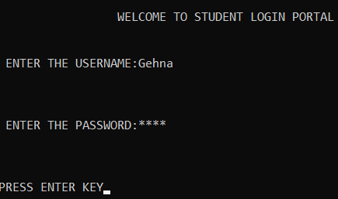
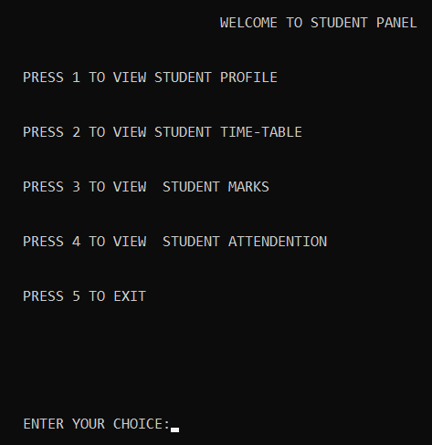

Slide 7

Presented by pankaj singh

